Slide 1

Pie Chart
Welcome to our lesson on pie charts! We'll explore what they are, why they're useful, and how to create them.

Slide 2

🌟 What is a Pie Chart?
A pie chart is a circle divided into slices (like a pizza or cake 🍕🎂).
Each slice shows how much part of the whole something takes.
The whole circle stands for 100% or all of something.

Slide 3


🌟 Why Do We Use a Pie Chart?
To make numbers easy to see and compare.
To show parts of a whole in a picture form.

Slide 4

Example: Pencils for Students
If a teacher gives students 100 pencils and:
Boys get 60 pencils 🎒
Girls get 40 pencils 👧
We can draw a pie chart showing:
Boys = more than half the circle
Girls = less than half the circle

Slide 5
🌟 Steps to Draw a Pie Chart
01
02
03
Collect the information (data).
Add up the total.
Change each part into an angle out of 360°.
04
05
Draw a circle and divide it into slices using a protractor.
Label each slice.

Slide 6
Formula for Angle of Sector
This formula helps us calculate the size of each slice in the pie chart.

Slide 7
🌟 Example: Favorite Sports
A class has 30 students:
15 like Football ⚽
10 like Basketball 🏀
5 like Volleyball 🏐
Step 1: Total = 15 + 10 + 5 = 30

Slide 8
🌟 Example: Calculate Angles
Step 2: Find the angle for each:
Football:
15
30
x
360
o
= 180
Basketball:
10
30
x
360
o
= 120
Volleyball:
5
30
x
360
= 60
o

Slide 9
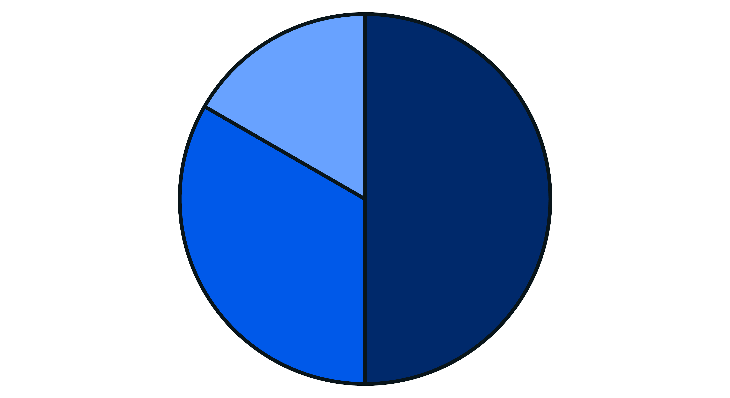
🌟 Example: Draw and Label
Step 3: Draw circle and divide into 180°, 120°, 60°.
Step 4: Label slices.
Volleyball
60
0
Football
180
0
Basketball
120
0
Football
Basketball
Volleyball

Slide 10
🌟 Key Things to Remember
Whole circle = 360° = 100%
Bigger number → bigger slice
Smaller number → smaller slice
Keep these points in mind when working with pie charts!

